Slide 1
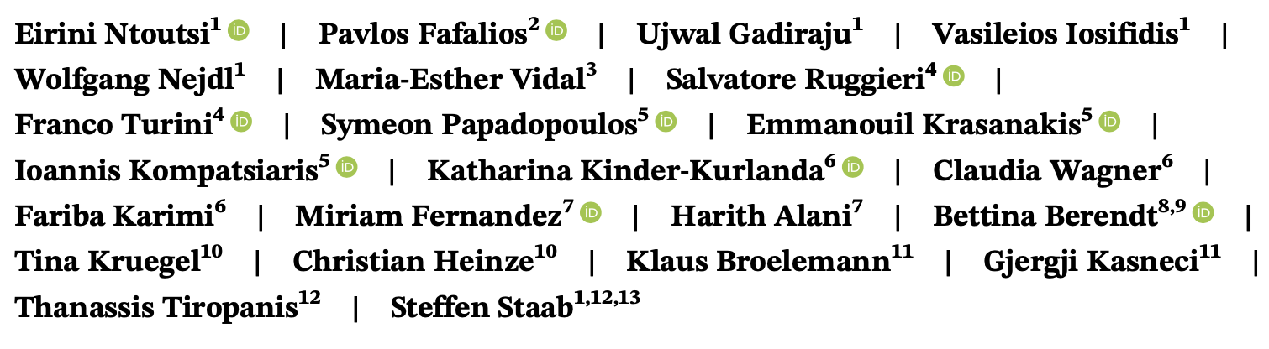
Bias in data-driven artificial intelligence systems—An introductory survey

Slide 2
Overview
Artificial Intelligence (AI)-based systems are widely employed nowadays to make decisions that have far-reaching impact on individuals and society.
Their decisions might affect everyone, everywhere, and anytime, entailing concerns about potential human rights issues.
Therefore, it is necessary to move beyond traditional AI algorithms optimized for predictive performance and embed ethical and legal principles in their design, training, and deployment to ensure social good while still benefiting from the huge potential of the AI technology.
The goal of this survey is to provide a broad multidisciplinary overview of the area of bias in AI systems, focusing on technical challenges and solutions as well as to suggest new research directions towards approaches well-grounded in a legal frame.

Slide 3
Overview
In this survey, we focus on data-driven AI, as a large part of AI is powered now a days by (big) data and powerful machine learning algorithms. If otherwise not specified, we use the general term bias to describe problems related to the gathering or processing of data that might result in prejudiced decisions on the bases of demographic features such as race, sex, and so forth.

Slide 4
Paper looks at
Commercial, Legal, and Ethical Issues > Fairness in Data Mining Commercial, Legal, and Ethical Issues > Ethical Considerations Commercial, Legal, and Ethical Issues > Legal Issues

Slide 5
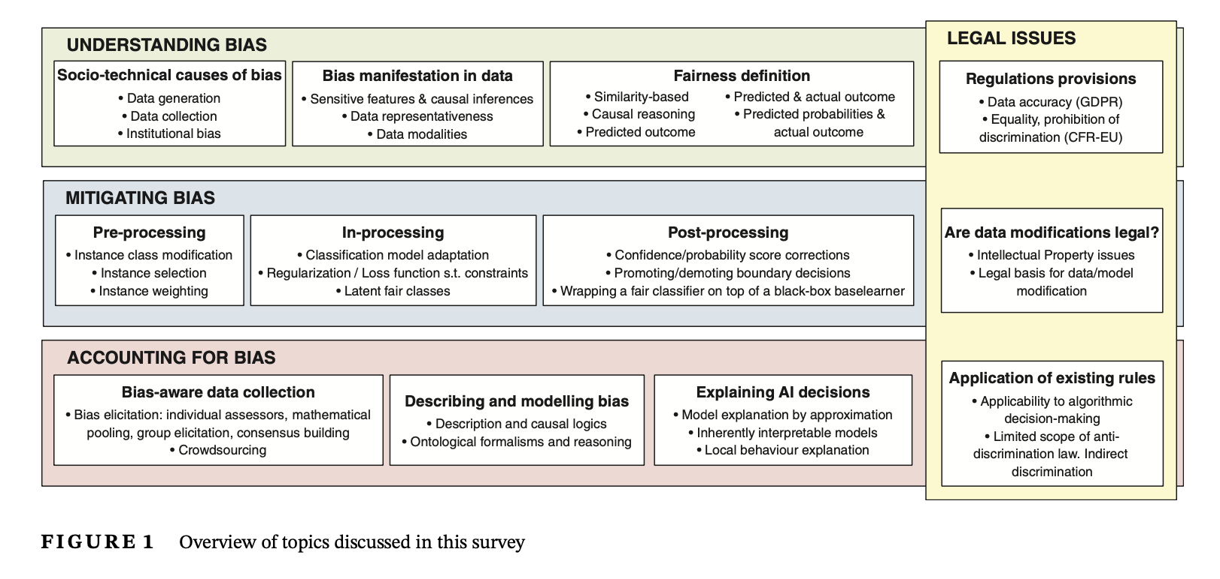

Slide 6
How is bias manifested in data?
Bias can be manifested in (multimodal) data through sensitive features and their causal influences, or through under/over-representation of certain groups.

Slide 7
Sensitive features and causal influences
Data encode a number of people characteristics in the form of feature values. Sensitive characteristics that identify grounds of discrimination or bias may be present or not.
Removing or ignoring such sensitive features does not prevent learning biased models, because other correlated features (also known as redundant encodings) may be used as proxies for them.
Representativeness of data
Data modalities and bias
Data come in different modalities (numerical, textual, images, etc.) as well as in multimodal representations (e.g., audio-visual content).
How is fairness defined?
More than 20 different definitions of fairness have appeared thus far in the computer science literature

Slide 8
MITIGATING BIAS
Pre-processing approaches
Approaches in this category focus on the data, the primary source of bias, aiming to produce a “balanced” dataset that can then be fed into any learning algorithm.
In-processing approaches
In-processing approaches reformulate the classification problem by explicitly incorporating the model's discrimination behavior in the objective function through regularization or constraints, or by training on latent target labels.
Post-processing approaches
The third strategy is to postprocess the classification model once it has been learned from data. This consists of altering the model's internals (white-box approaches) or its predictions (black-box approaches).

Slide 9
ACCOUNTING FOR BIAS
Algorithmic accountability refers to the assignment of responsibility for how an algorithm is created and its impact on society (Kaplan, Donovan, Hanson, & Matthews, 2019).
In case of AI algorithms the problem is aggravated as we do not codify the solution, rather the solution is inferred via ML algorithms and complex data.
AI accountability has many facets, we focus below on the most prominent ones that account for bias either proactively, via bias aware data collection, or retroactively by explaining AI decisions in human terms; furthermore, we discuss the importance of describing and documenting bias by means of formalisms like ontologies.

Slide 10
ACCOUNTING FOR BIAS
Proactively: bias-aware data collection
A variety of methods are adopted for data acquisition to serve diverse needs; these may be prone to introducing bias at the data collection stage itself
Retroactively: explaining AI decisions
Explain ability refers to the extent the internal mechanics of a learning model can be explained in human terms.
Legal issues of accounting for bias
Even if bias can be proven, a second issue is the limited scope of anti-discrimination law. Under present law, only certain transactions between private parties fall under the EU anti-discrimination directives (Liddell & O'Flaherty, 2018).

Slide 11
Future Work
Second, we recognize that “fairness cannot be reduced to a simple self-contained mathematical definition,” “fair- ness is dynamic and social and not a statistical issue.”
“fair is not fair everywhere” (Schäfer, Haun, & Tomasello, 2015)
meaning that the notion of fairness varies across countries, cultures and application domains.
Therefore, it is important to have realistic and applicable fairness definitions for different contexts as well as domain- specific datasets for method development and evaluation.

